Slide 1
SENG 1000 - Software Engineering Foundations and Practice
Sumati

Slide 2
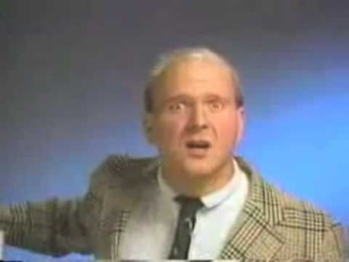

Slide 3
Topics
Introduction
Hardware and Software
How Computers Store Data
Why Python

Slide 4
Introduction
Computers can be programmed
Designed to do any job that a program tells them to
Program: set of instructions that a computer follows to perform a task
Collection of these programs or program itself is referred to as Software
Programmer: person who can design, create, and test computer programs
Also known as software developer

Slide 5
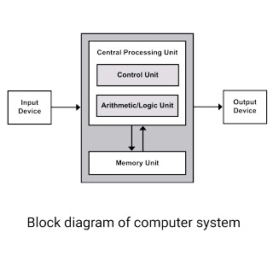
Hardware and Software
Hardware: The physical devices that make up a computer
Computer is a system composed of several components that all work together
Typical major components:
Central processing unit
Main memory
Secondary storage devices
Input and output devices

Slide 6
The CPU
Central processing unit (CPU): performs basic arithmetic, logic, controlling, and input/output (I/O) operations specified by the instructions.
It is the part of the computer that actually runs programs
Most important component
Without it, cannot run software
Used to be a huge device
Microprocessors: A microprocessor is a computer processor that incorporates the functions of a central processing unit (CPU) on a 1/more integrated circuit (IC).
The microprocessor is a multipurpose, clock driven, register based, digital integrated circuit that accepts binary data as input, processes it according to instructions stored in its memory and provides results (also in binary form) as output.

Slide 7
Main Memory
Main memory: where computer stores a program while program is running, and data used by the program
Known as Random Access Memory or RAM
CPU is able to quickly access data in RAM
Volatile memory used for temporary storage while program is running
Contents are erased when computer is off

Slide 8
Secondary Storage Devices
Secondary storage: can hold data for long periods of time
Programs normally stored here and loaded to main memory when needed
Types of secondary memory
Disk drive: magnetically encodes data onto a circular disk
Flash memory: portable, no physical disk
Optical devices: data encoded optically

Slide 9
Input Devices
Input: data the computer collects from people and other devices
Input device: component that collects the data
Examples: keyboard, mouse, scanner, camera
Disk drives can be considered input devices because they load programs into the main memory

Slide 10
Output Devices
Output: data produced by the computer for other people or devices
Can be text, image, audio, or bit stream
Output device: formats and presents output
Examples: video display, printer
Disk drives and CD recorders can be considered output devices because data is sent to them to be saved

Slide 11
Software
Everything the computer does is controlled by software
General categories:
Application software
System software
Application software: programs that make computer useful for every day tasks
Examples: word processing, email, games, and Web browsers

Slide 12
Software (cont’d.)
System software: programs that control and manage basic operations of a computer
Operating system: controls operations of hardware components
Utility Program: performs specific task to enhance computer operation or safeguard data
Software development tools: used to create, modify, and test software programs

Slide 13
How Computers Store Data
All data in a computer is stored in sequences of 0s and 1s
Byte: just enough memory to store letter or small number
Divided into eight bits
Bit: electrical component that can hold positive or negative charge, like on/off switch
The on/off pattern of bits in a byte represents data stored in the byte

Slide 14
Storing Numbers
Bit represents two values, 0 and 1
Computers use binary numbering system
Position of digit j is assigned the value 2^{j-1}
To determine value of binary number sum position values of the 1s
Byte size limits are 0 and 255
0 = all bits off; 255 = all bits on
To store larger number, use several bytes

Slide 15
Storing Characters
Data stored in computer must be stored as binary number
Characters are converted to numeric code, numeric code stored in memory
Most important coding scheme is ASCII
ASCII is limited: defines codes for only 128 characters
Unicode coding scheme becoming standard
Compatible with ASCII
Can represent characters for other languages

Slide 16
Advanced Number Storage
To store negative numbers and real numbers, computers use binary numbering and encoding schemes
Negative numbers encoded using two’s complement
Real numbers encoded using floating-point notation

Slide 17
Other Types of Data
Digital: describes any device that stores data as binary numbers
Digital images are composed of pixels
To store images, each pixel is converted to a binary number representing the pixel’s color
Digital music is composed of sections called samples
To store music, each sample is converted to a binary number

Slide 18
How a Program Works
CPU designed to perform simple operations on pieces of data
Examples: reading data, adding, subtracting, multiplying, and dividing numbers
Understands instructions written in machine language and included in its instruction set
Each brand of CPU has its own instruction set
To carry out meaningful calculation, CPU must perform many operations

Slide 19
How a Program Works (cont’d.)
Program must be copied from secondary memory to RAM each time CPU executes it
CPU executes program in cycle:
Fetch: read the next instruction from memory into CPU
Decode: CPU decodes fetched instruction to determine which operation to perform
Execute: perform the operation

Slide 20
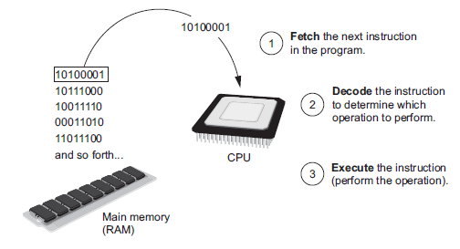
How a Program Works (cont’d.)
The fetch-decode-execute cycle

Slide 21
From Machine Language to Assembly Language
Impractical for people to write in machine language
Assembly language: uses short words (mnemonics) for instructions instead of binary numbers
Easier for programmers to work with
Assembler: translates assembly language to machine language for execution by CPU

Slide 22
High-Level Languages
Low-level language: close in nature to machine language
Example: assembly language
High-Level language: allows simple creation of powerful and complex programs
No need to know how CPU works or write large number of instructions
More intuitive to understand

Slide 23
Key Words, Operators, and Syntax
Key words: predefined words used to write program in high-level language
Each key word has specific meaning
Operators: perform operations on data
Example: math operators to perform arithmetic
Syntax: set of rules to be followed when writing program
Statement: individual instruction used in high-level language

Slide 24
Scripting vs. Programming
Python is a scripting language. Others include ActionScript, PHP, JavaScript, etc.
Java is a programming language. Others include C++, C#, etc.
What is the difference?
Often, Scripting languages are interpreted whereas Programmed languages are compiled into a more compact form that does not need to be interpreted by another application in the same way.
A scripting language like Python & JavaScript can be edited in a text editor whereas a compiled language generally cannot be extracted once it is compiled.
i.e. python text is fed into the python interpreter
i.e. "JavaScript is text that is fed into a browser that can read it and then is enacted by the browser."
Scripted languages may tend to be easier to learn, and can take less code to get something done.

Slide 25
Scripting vs. Programming
scripting language does not create any binary files (executables). For programming languages on compilation make binaries (either executables or libraries). These binaries executes from system’s memory.
"There are no actual concrete global difference between scripting and programming languages when it comes to the actual code."

Slide 26
Python Advantages
Object-Oriented
Dynamic Type Checking makes it inherently generic
Free, as in Open Source free
Portable
Powerful language constructs / features
Powerful toolkit / library
Mixable with other languages
Easy to use & learn

Slide 27
Python Toolkit
Dynamic typing
Built-in object types
Built-in tools
Library utilities
Third-party utilities
Automatic memory management
Programming-in-the-large support

Slide 28
How Python Is Used
System utilities
GUIs using Tkinter
Component integration
Rapid prototyping
Internet scripting
Database programming

Slide 29
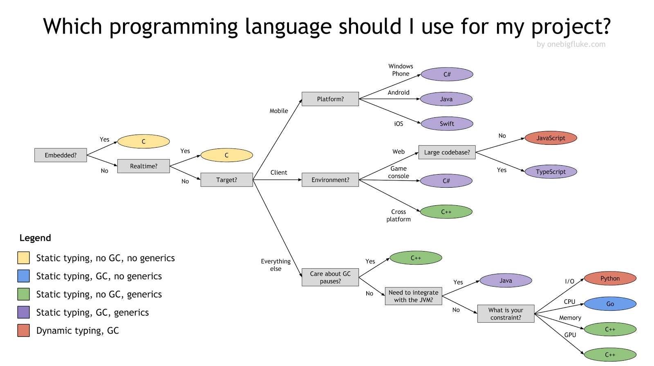

Slide 30
Getting Python
To check if python is already installed
python --version
To install Python
www.python.org
OR
$ brew install python
To install Anaconda
https://docs.anaconda.com/anaconda/install/

Slide 31
Python Principles
Python treats everything as an object
Python is an interpreter
It gives immediate results
It generates byte code (similar to Java)

Slide 32
Running Python
Interactively from console:
C:> python
>>> print(2*3)
6
As Python module files:
C:> python mypgm.py
Interactive prompt
No statement delimiter
Python modules are text files with .py extensions

Slide 33
Simple examples
Builtin print gives double quotes as single quotes. " and ' quotes are same.
Built-in and explicit print
>>> “Hello all”
'Hello all'
>>> print(“A b”)
A b
>>> ALongName = 177 / 2
>>> ALongName
88.5
print statement removes quotes

Slide 34
Basic Operations (1)
Assignment creates names
s = 'A string' # s is created
Names can be any length
Names are case sensitive
>>> A = 1; a = 2; A+a
3
Semicolons separates statements on the same line

